Slide 1
A-LEVEL SUBSIDIARY ICT NOTE
NAJJEMBE HOMELAND SEC SCHOOL
P.O.BOX 176, LUGAZI
For inquiry
Email: lukwagoshaban820@gmail.com

Slide 2
TOPIC 2: COMPUTER MANAGEMENT
Sub Topic 2.1 Booting Process
Sub Topic 2.2 File Management
Sub Topic 2.3 Common Utilities
Sub Topic 2.4 Print Management.

Slide 3
THE BOOTING PROCESS
Booting is the process of starting up a computer. During Booting, the operating system (OS) loads from disk into working memory (RAM) .
The process begins when a computer or powered on and ends when the computer is ready to perform its normal operations.
The types of booting
1. Cold booting/hard booting: This is the process of turning on a computer after it had been powered off completely.
2. Warm booting/soft booting: This is the process of restarting a computer that already is powered on.
24-Feb-11

Slide 4
Reasons for warm booting a computing
When the computer stops responding
After installing a software program
After uninstalling a software program
To recover from errors that cannot be recovered.
When a computer freezes or locks
When the computer slows down
When switching operating systems in case of multi-boot system
When a computer is infected with a virus
24-Feb-11

Slide 5
CONT…
After troubleshooting the computer
Automated software can also cause a warm boot.
Unexpected power loss can also cause a reboot
Under voltage can also cause frequent warm booting.
When a peripheral or hardware component has failed to function/work
When application software fails to work normally
During/After installation of operating system.
After changing use control settings(CMOS/BIOS settings)
When a user wants to clear a programs that are loaded in memory
After uninstalling hardware
After malware/virus scanning
When a deadlock occurs.
24-Feb-11

Slide 6
Benefits of restarting a computer.
It flushes RAM and removes other files that could be causing computer freezing.
Fast Performance: Reboots are known to keep computers running quickly.
Stops Memory Leaks. These occur when a program doesn't close properly.
Fixes Internet Connection
Recovers the computer from errors
24-Feb-11

Slide 7
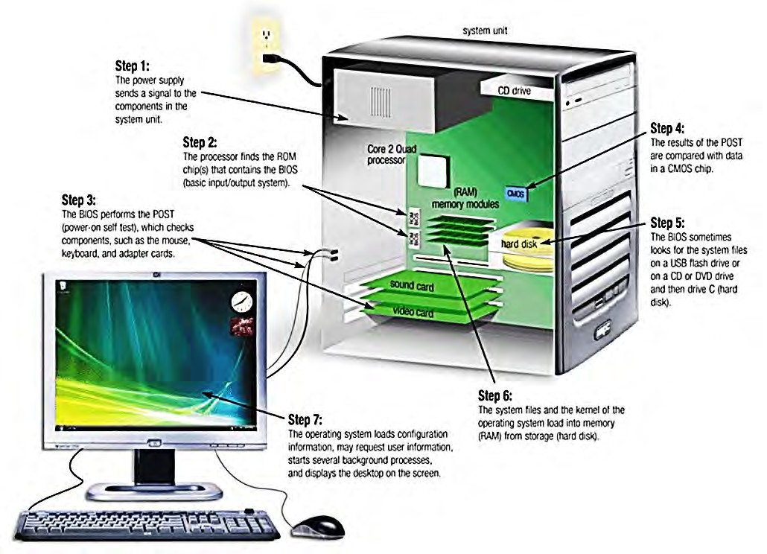
Step-by-step process of booting.
24-Feb-11

Slide 8
CONT…
The power supply sends a signal to the components in the system unit.
The processor finds the ROM chip(s) that contain the BIOS (Basic input/output system).
The BIOS performs the POST (Power-On Self Test) which checks components such as the mouse, keyboard and adapter cards. A series of messages may display.
The results of the POST are compared with data in a CMOS chip
The BIOS looks for system files on the boot device.
The system files and the kernel of the Operating System load into RAM from the boot device.
The OS loads configuration information and displays the welcome screen.
24-Feb-11

Slide 9
Terms used in the Booting process.
A boot loader is a computer program that loads the main operating system or runtime environment for the computer after completion of self-tests. Examples of boot loaders include NTLDR, BOOTMGR, GNU GRUB, Syslinux, etc.
A boot drive is the drive from which your personal computer boots (starts). In most cases, drive C (the hard disk) is the boot drive.
24-Feb-11

Slide 10
The concept of a computer program.
A computer program is a set of instructions that a computer uses to perform a specific task, such as word processing, accounting, or data management. Also called an application.
Almost everything you do on your computer requires using a program. For example, if you want to draw a picture, you need to use a drawing or painting program. To write a letter, you use a word processing program. To explore the Internet, you use a program called a web browser. Thousands of programs are available for Windows.
Starting a program
The Start menu is the gateway to all of the programs on your computer. To open the Start menu, click the Start button . The left pane of the Start menu contains a small list of programs.. To open a program, click it. To browse a complete list of all programs, click All programs.
24-Feb-11

Slide 11
FILE MANAGEMENT.
File management involves operations on files, programs and folders on computers disks.
File management operations include
Creating files and folders
Moving
Copying
Selecting single or multiple files (ctrl+click / Shift+click)
Renaming
Searching and Sorting by name, date or file extension (type)
Printing
Deleting
Restoring or emptying recycle bin etc.
24-Feb-11

Slide 12
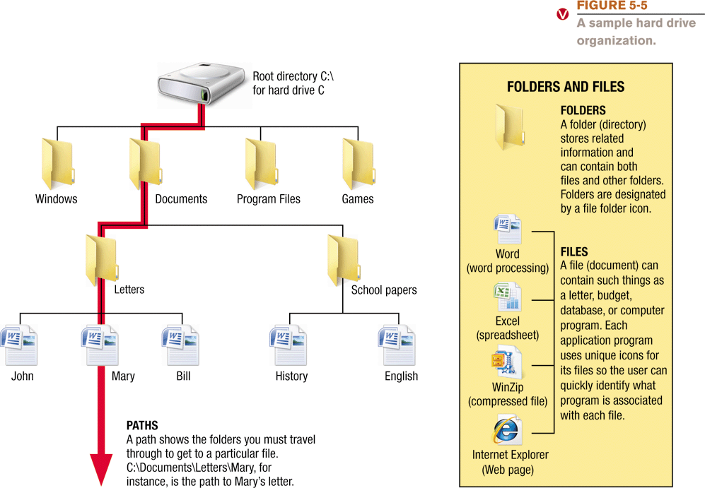
File management

Slide 13
Folders
A Folder is a virtual container for storing files and subfolders in the computer.
A folder is a named storage location where related files can be stored. In contrast, a file is a collection of related data saved with a given name on a storage medium.
A folder is also known as a directory in some operating systems.
All folders or directories originate from a special directory called root directory or folder. The root directory is represented by a back slash (\). A folder or directory may be created inside another folder or directory.
24-Feb-11

Slide 14
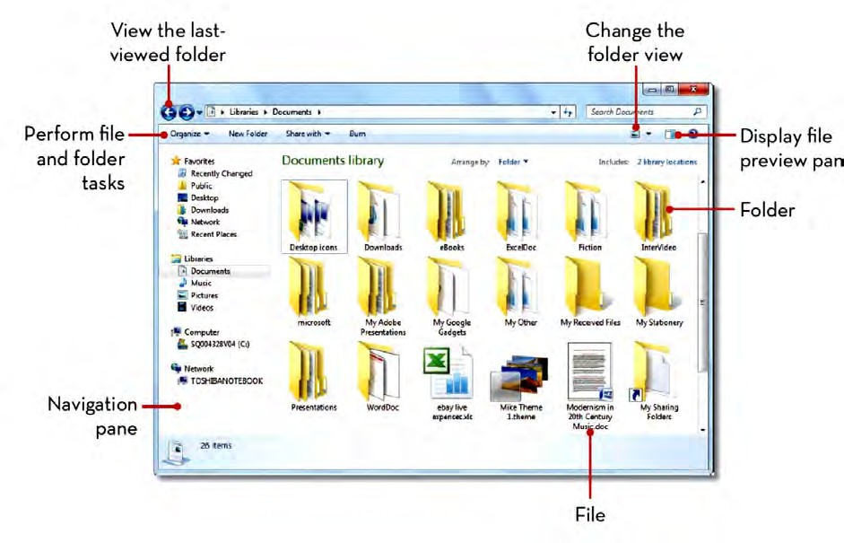
Cont.…

Slide 15
FOLDER/FILE OPERATIONS
Creating a new folder
Right Click on the free space on the desktop,
Point to New, click folder. Type a new name for the folder
Renaming a folder or file
Right Click on folder or file and choose Rename option from the pop up menu. OR.
Select the file or folder icon and Press F2 function key, Type the new name, and then press Enter key
Deleting a folder or file
Right Click on folder or file and choose DELETE option from the pop up menu. OR.
Select the file or folder icon and Press DELETE key, A message appears on the screen asking whether you actually want to delete the item. Confirm by clicking Yes
24-Feb-11

Slide 16
CONT…
Restoring deleted files and folders
In Windows, when you delete an item from the hard disk, it is temporarily held in a special folder called the Recycle bin from where it can be restored if necessary.
To restore a file or folder from the recycle bin to its original location proceed as follows:
Double click the Recycle Bin icon.
Select the deleted item(s) to be restored.
Click File then Restore

Slide 17
Copying files and folders
Cut is a command used to move an item, while copy is a command used create a duplicate of an item. When you cut or copy an item, it is temporarily held in a temporary storage location known as the clipboard.
To copy a file or folder:
Select the file or folder right click, on the pop up menu choose copy option.
Select the drive or folder where you want the item to be copied, Right Click, then choose paste.

Slide 18
Cont.…
To move a file or folder proceeds as follows:
Select the file or folder Right click, on the pop up menu choose copy option.
Select the drive or folder where you want the item to be moved, Right Click, then choose paste.
Moving a folder
To move a folder to a desired location:
Click the folder and hold
Drag and drop to the desired location
To sort files and folders:
Right-click any open space within Windows Explorer and select SortBy.
Choose to sort by Name, Date modified, Type, or Size.
To view more sorting options, click More

Slide 19
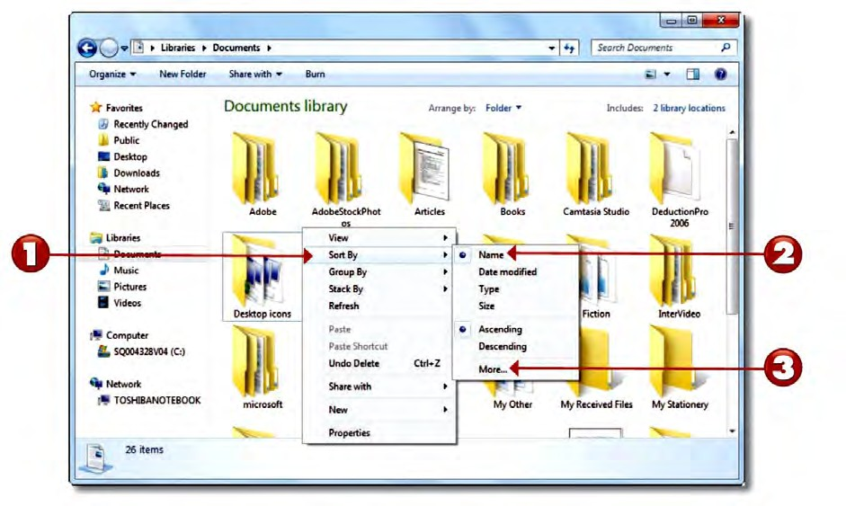
Cont.…
l

Slide 20
Files
A file is a collection of bits that have been processed and stored in secondary memory.
A file is a collection of related data saved with a given name on a storage medium
Every document, picture, sound or video saved on a computer’s storage is a file.
A file is associated with the program that is used to read it, so if you double- click a file that was created in Microsoft word, the Microsoft program starts and displays the file.

Slide 21
Types of files
There are three types of files namely:
System files: contain information that is critical for the operation of the computer.
Application files: holds programs and are executable.
Data files: contains user specific data.
File Attributes:
Every file has the following details:
A file name and an optional extension. The name and extension are separated by a dot (.) e.g. Jack.doc. In this case, the file name is Jack and the extension is doc.
The size in bytes, date, and time the file was created.
A file extension is a suffix to the file name applied to indicate the file format. It is separated from the base filename by a dot.

Slide 22
Table below shows some file extension and whether it is a system, application or a data file.
Extension | File type | Description
.doc, .docx | Data | Microsoft Word document file.
.xls, .xlsx | Data | Microsoft Excel document file.
.csv | Data | Comma Separated Values
.rtf | Data | Rich text format Word Document
.ppt. .pptx | Data | Microsoft PowerPoint document file.
.pub | Data | Microsoft Publisher document file.
.accdb, .mdb | Data | Microsoft Access document file.
.txt | Data | A plain text file created using note pad editor
.mp3, .wma | Data | An Audio file
.mp4,.mpg, .mov | Data | A video file.
.jpg, .png, .bmp | Data | An Image file
.exe | Application files | The file that launches a particular application, e.g. winword.exe
.bat | System files | Files containing a series of commands loaded during boot up.
.sys | System files | System files that perform fundamental operations in a computer.

Slide 23
Some file extensions and their description
File extension | Description | Type
GIF | Graphic Interchange Format | Graphics
JPEG | Joint Photographic Expert Group | Graphics
PNG | Portable Network Graphics | Graphics
BMP | Bit Map | Graphics
TIFF | Tagged Image File Format. | Graphics
ACC | Advanced Audio coding | Audio
AIFF | Audio Interchange File Format | Audio
MP3 | Moving Picture Expert Group Audio Layer 3 (MPEG-3) | Audio
WAV | Windows Waveform | Audio
WMA | Windows Wave Audio | Audio
APK | Android Package File | application
PPT | Power Point Presentation | data
MP4 | Moving Pictures Expert Group | video
EXE | Executable file | application
BAT | Batched files | command
PDF | Portable Document Format | Document / data
LOG | Log files
AI | Adobe Illustrator

Slide 24
File Specification and File path
A file specification :is the name given to identify a file. The path is the first part of the file specification. The file name and extension make up the remainder of the file specification. Also, In Windows, the folder containing information specific to one user, including the My Documents, Desktop and the like is commonly known as the Profile.
For example, the file specification
C:\Users\Rogers\Desktop\Music\Gospel\Worship.mp3
Identifies the file named Worship.mp3 in the Gospel subfolder under Music folder on the Desktop (Location) under Rogers’ Profile in the Users directory on Disk Drive C. The file extension .mp3 denotes that Worship.mp3 is an audio file.

Slide 25
Cont.…
A file path: is a designation that specifies how to find a file on a disk that has more than one directory. In Windows, paths have either of two forms. For example,
\AAA\BBB\CCC
Means, “In the root directory there is a directory called AAA. In AAA there is a directory called BBB. In BBB there is a directory or file called CCC.”
If the initial backslash is left out, the path starts at the directory currently in use rather than at the root directory. For example, the path
C:\Program Files\Database\DBASE.exe (or whatever).
The root directory is the "C:\" part.
"Program Files" is the next level Directory.
"Database" is a subdirectory under "Program Files", and
"DBASE.exe" is the actual file name.

Slide 26
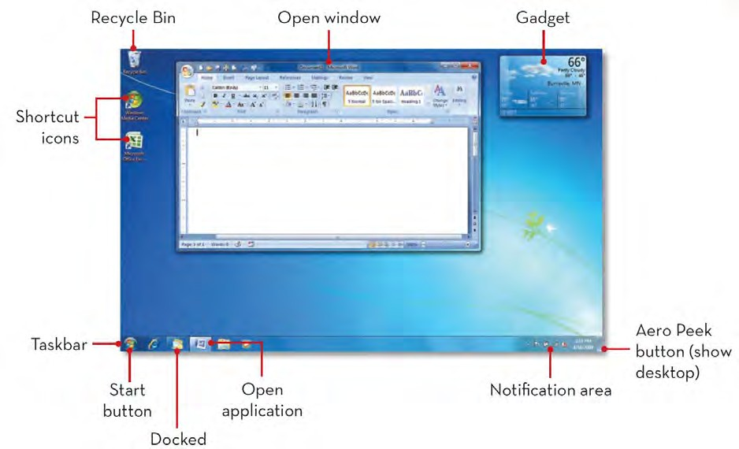
Desktop
The desktop is the main screen area that you see after you turn on your computer and log on to Windows or other operating system with a GUI.

Slide 27
Major features of a windows desktop.
Desktop Background: Windows lets the user to customize the desktop background by applying favorite themes, colors, pictures and wallpapers.
Icons: An icon is a graphical representation of a program on the screen. Icons are mostly manipulated using a pointing device e.g. the mouse.
Taskbar: The taskbar enables the user to easily switch between different programs and tasks that are currently running. Whenever the user starts a program or opens a file, its button appears on the taskbar and stays there until the user exits the program.

Slide 28
Cont.…
System tray/Notification area: The notification area, on the far right side of the taskbar, includes a clock and a group of icons that communicate the status of something on the computer or provide access to certain settings.
Start button: The left most button on the taskbar that the user clicks to display the start menu.
Using screen savers
Screensavers display moving designs on your computer screen when you haven’t typed or moved the mouse for a while. This provides some small degree of entertainment if you’re bored at your desk

Slide 29
COMMON UTILITIES
Utility program is system software designed to enhance the working conditions of a computer.
Utility software refers to the system software designed to analyze, configure, optimize, and maintain a computer is its best working state
Utility programs include:
Backup programs. These programs let you protect your files by making copies of them.
Data recovery. These are programs used to restore data that has been physically damaged or corrupted.
Data compression programs. are utilities which are used to remove redundant elements, gaps and unnecessary data from a computer’s storage space.

Slide 30
Cont.…
Debuggers. These are programs which correct errors in a computer program.
Defragmenters. Are programs which bring fragments of a file together for storage in one location in the computer memory.
Anti-virus programs. These software protect your system from viruses. They include; Mac fee, Avira, Avast etc.
Disk maintenance utilities like Norton disk doctor, scandisk etc. are programs that detect errors on a computer disk and fix them.
Search utility: used to locate a file or folder by name located on any of your hard drives in less than a second.
File compression utility: reduces the amount of space used by files stored on that drive.
Screen saver: Takes over screen and displays graphics after some period of inactivity. Used primarily for entertainment or security. Prevents CRT from phosphor burn-in (ghosting)

Slide 31
THE PRINT MANAGEMENT
Printing refers to the process of producing softcopies of documents into hardcopy like a plain paper.
To print a document;
Click file menu of an application program.
Choose option print. This will bring the print dialog box
Select the printer name i.e. HP Deskjet F4200 series and change the necessary preferences such as A4 paper size for advance setting by clicking on the preferences button.
Click Print button when done

Slide 32
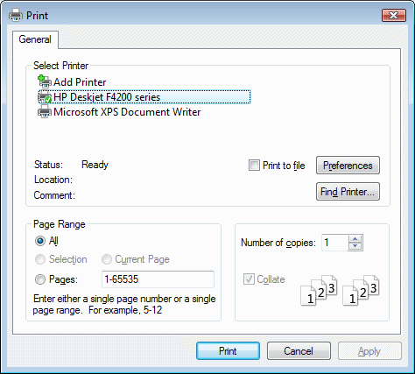
Cont.…

